Slide 1

Fall 2013 –
All College Day
Presented by the WVC Distance Learning Committee

Slide 2
Hot Topics - Overview
Student identification
Last day of attendance
Correspondence vs. Distance Ed
  Regular and effective contact
Accessibility and ADA compliance

Slide 3
Student Identification
HEOA 2008 - Requires institutions to verify the identity of a student
Secure login/passcode for Each Student
  ANGEL requires unique login
Need to Continue to Improve
  Other technologies and practices that are effective in verifying student identification
  Proctored examinations?

Slide 4
Last Day of Attendance
Date used to calculate the amount of Title IV (Financial Aid) refund when a student withdraws from a course
The later the LDA, the less refund
All Instructors (esp. DE) need to determine when students stop participating in class
For Fall 2013 = October 31, 2013
(Always 60% of Semester)

Slide 5
Hands-on Workshops
Regular and Effective Contact Using Discussion Forums and Announcements
Wednesday, September 4
3 – 4:30 PM – Room Fox 104
Creating Accessible Documents
Wednesday, September 18
3 – 4:30 PM – Room Fox 104

Slide 6
Correspondence vs. Distance Ed
Students separated from instructor
Students separated from instructor
Instructional material provided via mail or electronically
Instructional material provided electronically
Regular and substantive interaction between (i.e., regular & effective contact):
  Students and instructor
  students and students
  Students and text
Limited interaction between students & instructor; primarily initiated by students
Course typically self-paced
Regularly scheduled, graded assignments, set due dates for quizzes, exams

Slide 7







Regular and effective contact – Engagement Tools
    Office Hours & Phone Calls
    Regularly Scheduled, Graded Assignments
    Progress Reports
    Discussion Forums and Blogs
    Email and Front Page Announcements
    Group Projects
    Video Conferencing (ccconfer.org)

Slide 8

Two Easy Tools that ANGEL Offers
Announcements
  Weekly to Keep it Current
  Course News (Reminders)
  Add Color / Change Fonts / Add Image

Slide 9
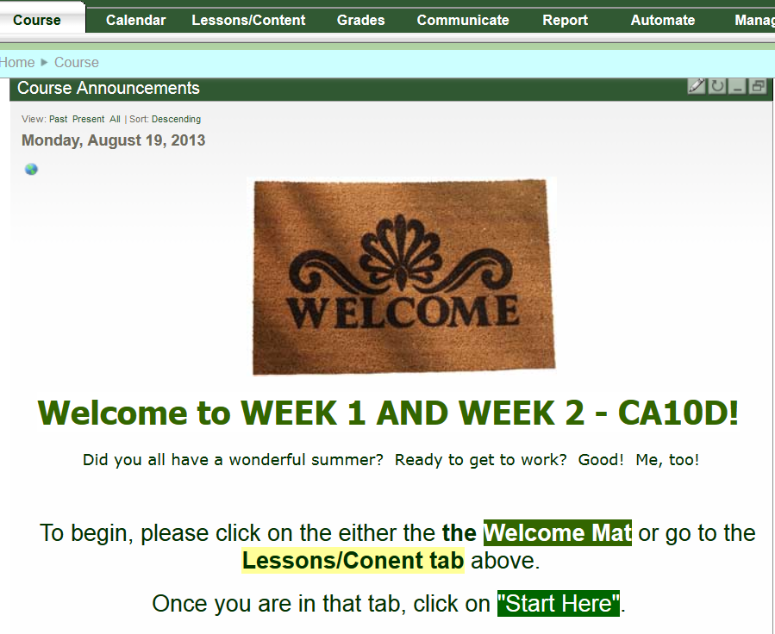

Slide 10

Discussion Forums
  Three places you can access forums once they are created
  Use open-ended questions and be specific to avoid short responses
  Forum modes
  Make them mandatory by grading your forums

Slide 11
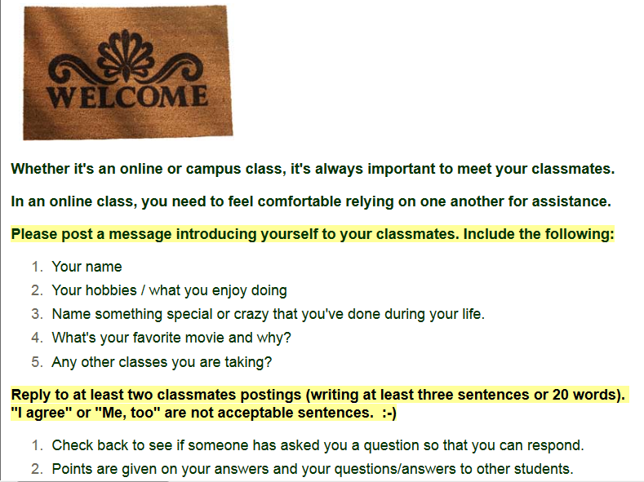
Sample “Meet and Greet” Discussion Forum

Slide 12

Accessibility & ADA Compliance:
It’s the LAW!
Closed Captioning of media
  DECT Grant
Making Word docs accessible
Alternate description (alt tags) for images
Converting accessible Word docs to PDF files

Slide 13
Captioning $$
DECT Grant – Free Captioning!
  (usually $3.35-$4.35/min. depending on format requested)
  Email notice sent every semester
  New content only
      self-created or other formats
  Must be placed online for course
      Course may be f2f, hybrid, online
  Captioning stations available in AV in future

Slide 14
Training Topics
  Accessible Word to PDF
  PDF – Acrobat Pro
    (Site License for All Faculty)
  Publisher PDFs/course content
    Their responsibility!
    Magic Words:
      “508 or ADA Compliant”

Slide 15
  Future Trainings
    Accessible Word
    Accessible PDF
    Accessible PowerPoint
    Captioning
    Alt tags
    Others?

Slide 16
“Good is better than bad… even if it’s not perfect!”
  Alternate Media and Assistive Technology
  DESP Lab – Appointments for Advice/Help
  Trainings
  Angel Module (PG&D Credit)
  Resource Page and HTCTU (htctu.net)
  Anne Crosby
    anne.crosby@westvalley.edu
    DESP – (408) 741-2063

