Slide 1

Success and Retention
African American Students
Ms. Ekua Armah

Slide 2
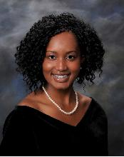
Introduction
Freshman
Psychology/Pre-Med
First-Generation Student
Educational Career

Slide 3
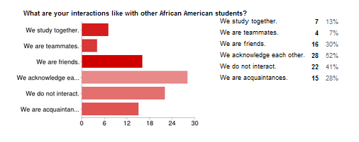
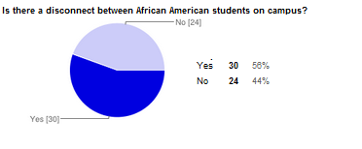
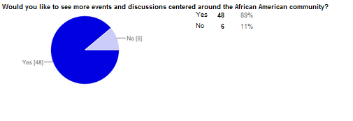
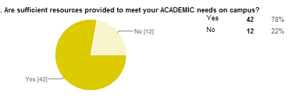
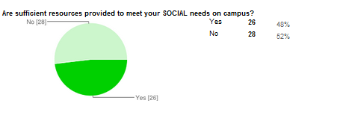
Survey

Slide 4

Focus Group
1. Do you think there is a disconnect
between African American Students on campus?
2. Do you think there are sufficient resources provided to meet your academic needs?
3. Do you think there are sufficient resources provided to meet your social needs on campus?
4. What resources have you taken advantage of on campus?
5. What kind of support can faculty and staff provide you with for your educational goals?
6. What could the campus do to support you through challenges that have prevented or slowed your progress towards academic success?

Slide 5
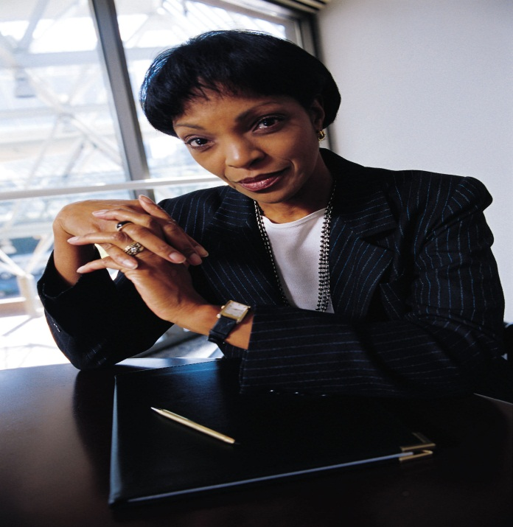

Recommendations
More African-American Faculty & Staff
Zero-Tolerance Environment
Othermothering
Support System

