Slide 1


Slide 2


Slide 3

Education, Training &
Resource Development

Slide 4


Health Awareness Outreach
August 2012 – Kognito At-Risk Online Training Initiated (3 modules)
April 2013 – Completion Rates after three major campaigns:
At-Risk Friends/Student Module 415
At-Risk Faculty/Staff Module 61
At-Risk Veteran’s Module 13

Slide 5

Health Awareness Outreach
Fall 2013 – Three new training modules!
LGBTQ for Faculty & Staff
LGBTQ for Students
Veterans Peer-to-Peer

Slide 6
Health Awareness Outreach
College-Wide Events:
August 2012 – All College Day Suicide Prevention Training (60)
October 2012 – Depression Screening Day (13)
October 2012 – “Wong Flew Over the Cuckoo’s Nest” presentation (70)
December 2012 – QPR Training at SJCC (50)
January 2013 – All College Day Civility Workshop (80)
February 2013 – NAMI “In Our Own Voice” (175)
April 2013 – Wheel of Wellness Event (60)
May 2013 – National College Health Assessment (559)
August 2013 – All College Day Mental Health Showcase (100)
October 2013 – Send Silence Packing (1,500+)

Slide 7

Peer Resource Development
Associated Student Organization (ASO); Health & Wellness Subcommittee
Kognito At-Risk Modules – Promoted by Students
Focus Groups – Student Veterans; Puente Students; SUCCESS Students
NAMI on Campus Club – initiated/run by students

Slide 8
Behavioral Assessment & Intervention Plan Development

Slide 9

Mental Health Services Advisory Committee
MHSAC
Weekly Educational Focus
Monthly Student of Concern Forum
Assisting the Distressed Student Guide
Multidisciplinary team includes: Faculty, Staff, Administrators, Students
WVMCCD Police, and Student Support Services

Slide 10
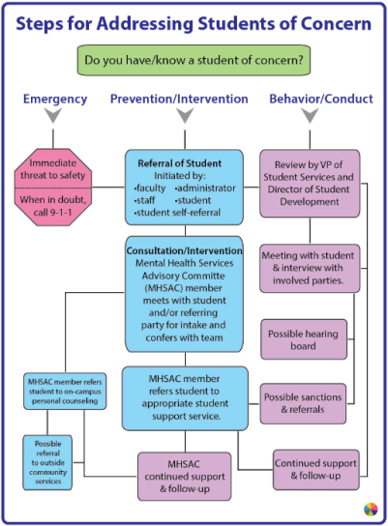
Do you know a student of concern?
Behavioral Assessment
And Intervention Plan
Students of Concern Process Map
Monthly Tracker
Quarterly Summary Report
Incident Report Form

Slide 11
Integrated Clinical &
Mental Health Care

Slide 12

Student Health Services
Participated in National College Depression Partnership (NCDP)
All students screened for depression during initial visit
Mental Health referral initiated if indicated
Home of Mental Health Graduate Internship Program

Slide 13

Mental Health Graduate Internship Program
Four Graduate Interns (MSW, MFT)
Co-located and supervised within Health Services
Approximately 80 hours of Personal Counseling provided
Graduate Projects – Focus Groups; NAMI on Campus
“Coming to talk to you untangles these thoughts I have in my head.”
– WVC Student

Slide 14
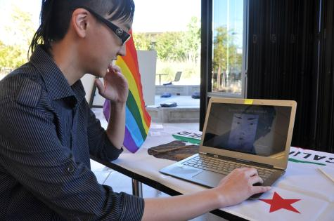
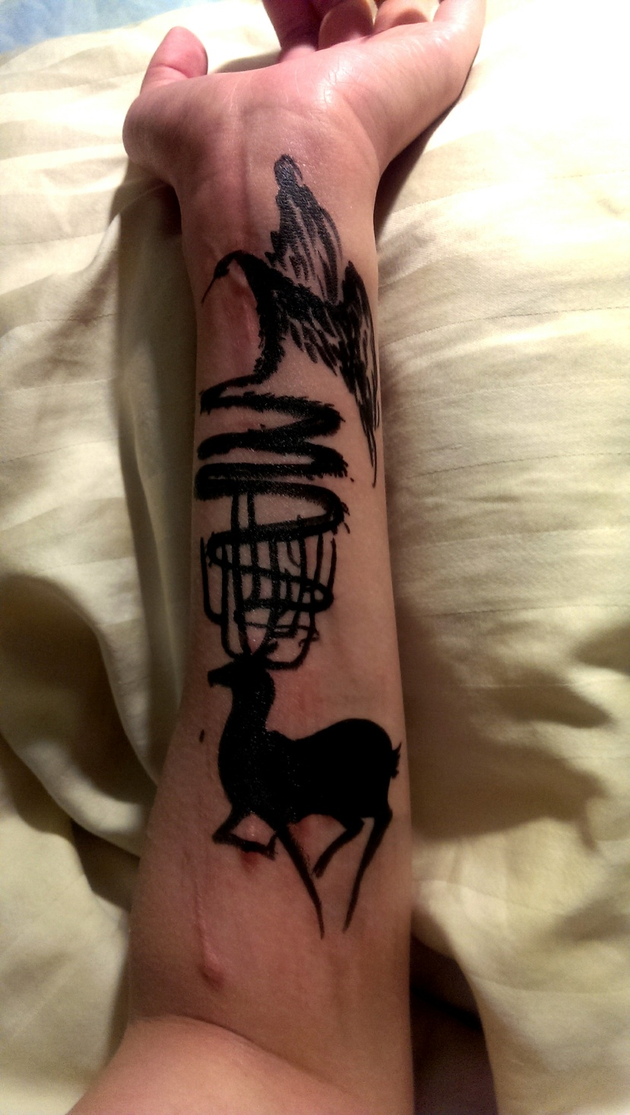
Mental Health Graduate Internship Program
“Healing”
2013. 9

Slide 15


Formulate County Mental Health Referral
Hosted Regional Strategizing Forum November 2012 (50 attendees)
Will host November 2013 Regional Strategizing Forum
Developing Warm-Hand Referral Process to County Mental Health
CCCStudentMentalHealth.org

Slide 16
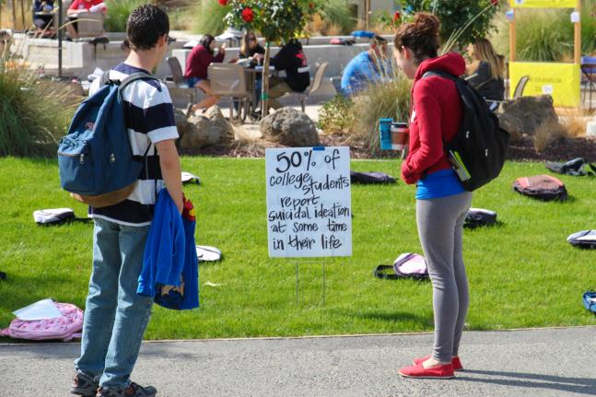
Building Momentum into the Future
Institutional Commitment to Embrace a Campus
Culture of Student Mental Health Support

Slide 17
Building Momentum into the Future
Institutional Commitment to Embrace a Campus
Culture of Student Mental Health Support
Sustainability of:
Mental Health Services Advisory Committee
Behavioral Assessment and Intervention Plan
Graduate Intern Program
Student Health Services

Slide 18
Building Momentum into the Future
Institutional Commitment to Embrace a Campus
Culture of Student Mental Health Support

