Slide 1
EAP Manager Orientation
West Valley-Mission
Community College District
Claremont EAP
Laurie Slez, VP Account Services
800-834-3773
www.claremonteap.com

Slide 2
Claremont EAP Background
Has been dedicated to providing EAP services for Bay Area employers for 20 years
Particular focus on public sector employers with clients including AC Transit, Alameda County, BART, EBMUD, SF MTA (MUNI), SMCCD, City of Berkeley among others
Experienced, committed staff
High touch program that operates as integral part of the organizations we serve

Slide 3
Claremont EAP – The Basics
Eligibility: All full and part time permanent employees are eligible on date of hire
  Family members living in the immediate household
  Domestic partners
  Children up to age 26
Access: All care should be pre-authorized by calling Claremont at: 800-834-3773
Hours: 8:00 AM to 5:00 PM, M-F
  MA level Clinicians available 24/7 for urgent matters

Slide 4
EAP Services
Counseling
Legal Consultation
Financial Services
Work/Life Referrals
Community Resources
Unlimited Management Consultations
Critical Incident Stress Debriefings
Brown Bags
Training

Slide 5
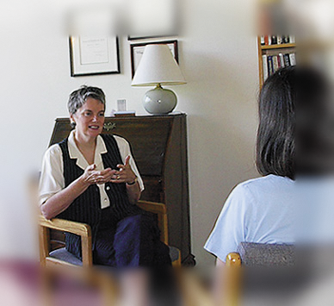
Counseling
3 visits per incident
Help with any problem:
  Marital/family/relationship issues
  Emotional issues like stress, anxiety, depression, grief
  Work concerns
  Substance Abuse
Panel of licensed clinicians in private practice
Day and evening appointments available
Referrals to specialist close to work or home
Negotiated rates available for continuing care

Slide 6

Confidentiality
Confidentiality is vital to effectiveness
No information disclosed without signed written consent
Legal exceptions to confidentiality:
  Suspected child or elder abuse
  Danger to oneself
  Threats of violence

Slide 7

Legal Advice
One consultation per issue, 25% discount
  Divorce, child custody
  Car accidents
  Real estate issues
  Estate planning (free
  (Free Simple Will Kits)
Exclusion
  Employment Law

Slide 8

Financial Consultation
Budgeting
Debt management
Financial planning
Tax questions
First-time home buyer program
Free credit report and consultation
Identity theft program

Slide 9

Work/Life Referrals
Nationwide referrals and consultations:
  Child/elder care
  School/college assistance
  Adoption assistance
  Convenience referrals
  Wellness referrals
Clients provided with report of local services that address specific needs

Slide 10
Claremont Personal Advantage Website
Family Life – Over 2,000 articles on topics such as Parenting, Managing Work/Family, Education and Aging
Health – Over 3,000 articles covering more than 400 conditions and dozens of tools and resources
Financial – Over 500 articles and 300 different calculators
Legal – Over 1,000 articles on major legal issues
Emotional Wellbeing – Over 2,000 articles on topics such as stress, anxiety, depression, and many more
Register at www.claremonteap.com with Company Name - ‘WVMCCD’

Slide 11
Consultation for Managers/HR
EAP helps identify, motivate and assist employees who have personal problems which currently or predictably affect work performance
Help with conflicts, attendance, work stress, personal problems, substance abuse, critical incidents etc.
Action plan developed which may include counseling, CISD,conflict resolution, coaching, training

Slide 12

Why Use Mgt Referrals?
Allows managers to maintain a focus on work performance while the EAP addresses underlying causes
Gives employees every opportunity to correct problems
Puts responsibility for improving work performance on the employee

Slide 13
EAP Referral Triggers
Work Discipline
Workers’ Comp and Disability Claims
Financial Events
Employment Practices Complaint
Organizational Change
Threats of Violence
Critical Incidents

Slide 14

HR/Management Referrals
Informal Referral
  EAP does not report back re. employee’s participation
Formal Referral
  Employee signs a Release of Information Form
  EAP reports back re. employee’s participation

Slide 15

EAP Onsite Services
Critical Incident Stress Debriefings (3 hours per incident)
Brown Bag Seminars (up to 10 hours per contract year)
Training/
Organizational Assistance

Slide 16

WVMCCD/Claremont Partnership
  Provides infrastructure and tools
WVMCCD
  Supports promotional efforts
  Integrates program into day-day functions
Success is based on strength of our partnership

