Slide 1
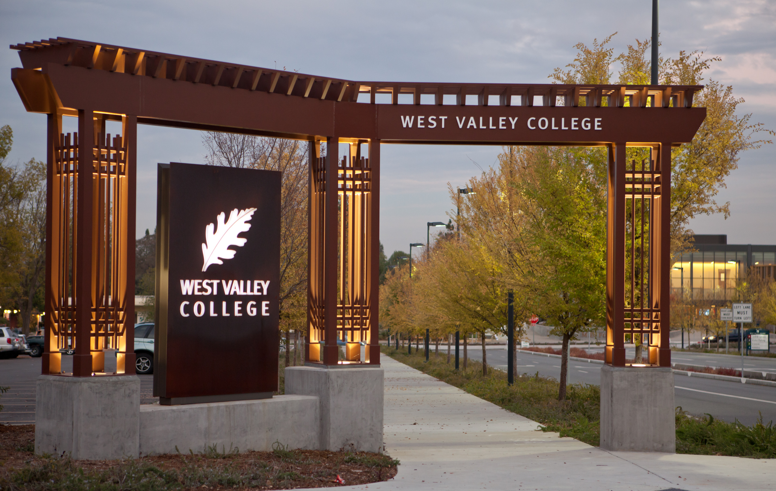

ACCREDITATION AND INTEGRATED PLANNING
All College Day
August 23, 2013
Notes:
Kuni

Slide 2


Accreditation
The Homestretch to Reaffirmation!
REAFFIRMED
Notes:
Kuni

Slide 3



Vikings Advance!
Fall 2013
Self Study report - 80% complete!
Input from governance groups & BOT
Going Forward- Complete Self Study report, finalize evidence, prepare Resource Room
Spring 2014
In January 2014, submit Self Study report to ACCJC
Prepare for March 17th team visit at college and hotel site
Notes:
Heidi

Slide 4


News Flash!
CCSF Accreditation may be revoked in 2014
What not
to do!
Don’t ignore ACCJC requests!
Don’t assume we can just get through it!
Don’t avoid ACCJC deadlines!
Don’t tweak the nose of the gorilla!!
Notes:
Kuni

Slide 5
Accreditation
Path to ensure success!
Integrated Planning Process
Curriculum Committee Process
Distance Education Program
Mission Statement Linked to Planning
Participatory Governance Process informs Decision Making
College Catalog is accurate and timely
Goals & Objectives derived from College Mission
Chancellor & BOT have clearly established goals
BOT determines policies and doesn’t manage district or colleges
Notes:
Heidi

Slide 6

Accreditation
Path to ensure success!
WE CAN DO THIS!
Notes:
Heidi

Slide 7

Steering Committee Fall 2013 Focus
Complete Self Study Report with Linked Evidence
Help Coordinate District Services & College Operations
Clarify integrated planning process for College
Promote timely SLO Assessments and Program Review completions
Identify an Accreditation Resource Room
Set up required hard copy evidence
Notes:
Kuni

Slide 8

College Community Fall 2013 Focus
Most Importantly
We Need YOU!
Notes:
Kuni

Slide 9




College Community Fall 2013 Focus
I
  Integrated Planning Process is owned and embraced
II
  Student Success is a college wide commitment and value
III
  DE Committee ensures that all DE courses comply with state and federal regulations
IV
  The steering committee will distribute an “Accreditation Check List” college wide
Notes:
Heidi

Slide 10



Spring 2014 Focus
By Jan 2014, we will submit self study report to ACCJC
ACCJC will introduce the Visiting Team to the College
Accreditation Leadership team will prepare for March visit
Resource team will organize evidence
Accreditation Leadership sets up on & off site Visiting Team locations
Accreditation Leadership Team needs your help!
Notes:
Kuni

Slide 11
The Accreditation Perspective on Integrated Planning
An effective institution demonstrates a conscientious effort to produce and support student learning, measures that learning, assesses how well learning is occurring, and makes changes to improve student learning.
It also organizes its key processes and allocates its resources to effectively support student learning.
Further, it sets goals to improve its effectiveness consistent with its stated purposes.*
*ACCJC-WASC Accreditation Standards
Notes:
John

Slide 12
Integrated
Planning
College Mission
Program Review & SLOs
Developed Goals
Resource Allocation
Implement-ation
Having an Effective College Planning Process is Critical!
Notes:
John

Slide 13
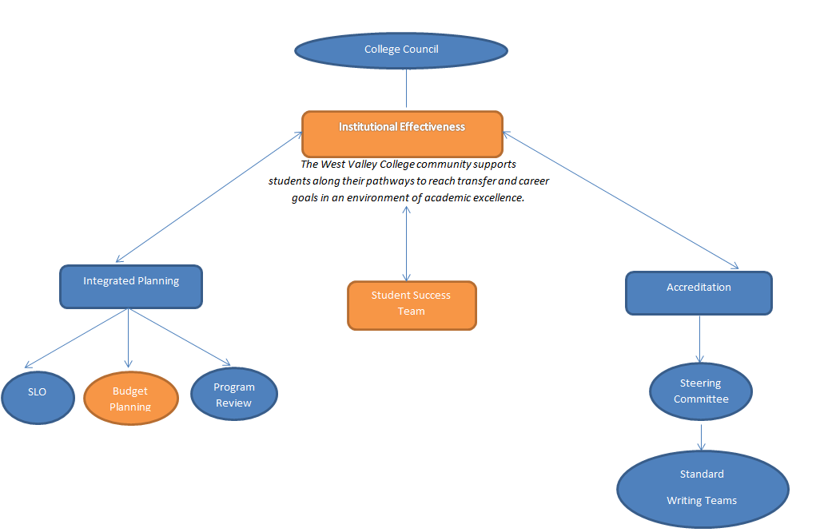
Integrated Planning:
2012-2013 to 2013-2014
West Valley College Institutional Effectiveness
Notes:
Kuni
The next part of this presentation will:
Describe how SLOs, PR, & Budget Planning will integrate in 2013-14
Help the college understand the integrated planning cycle and how it has evolved
Update each area and how it merges with the college’s integrated planning process

Slide 14
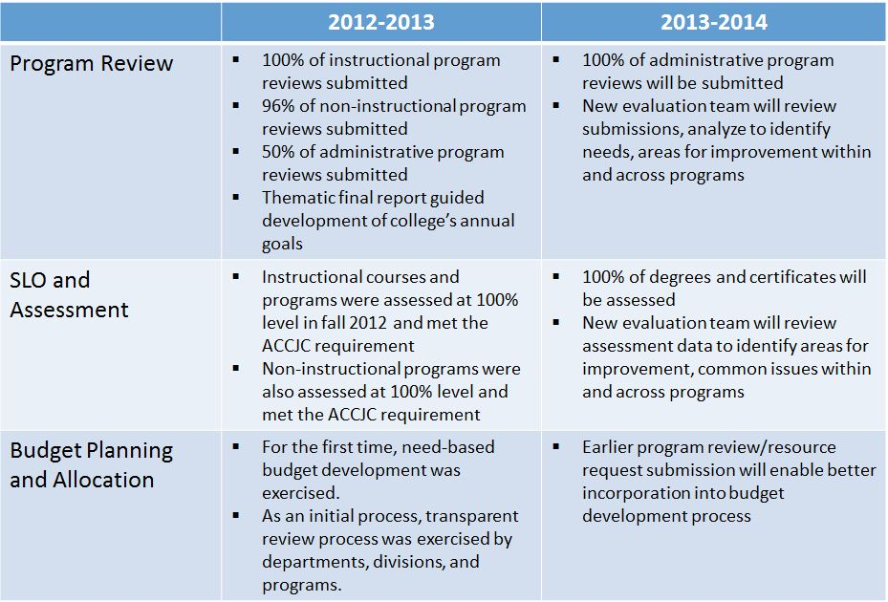
Integrated Planning:
2012-2013 to 2013-2014
Notes:
Stephanie

Slide 15
Integrated Planning: 2012-2013 to 2013-2014
The processes come together:
Program Review
SLO/
Assessment
Budget Planning
Notes:
Stephanie

Slide 16


SLOs & A: Keep on Keepin’ on!
Feedback and Review Process Planned
New User Friendly SLO & PLO Assessment forms!
New SLO & Assessment Webpage!
Easy to use Email Submission System!
SLOsubmit@wvm.edu
Master Program Review & SLO & Assessment Schedule
Notes:
Michelle

Slide 17


Program Review:
Progress and Next Steps
1
  New questionnaire including SLO assessment questions developed in 11-12
2
  New 2 year program review cycle
2012-13
PROGRAM REVIEW THEMES REPORT
3
  Improved online reporting mechanism to be more user friendly
4
  Thematic review in progress
5
  Draft evaluation rubric in progress
2013-14 BUDGET
Notes:
John

Slide 18
Resource Allocation:
Progress and Next Steps
Program review themes informed resource allocation decisions in 12-13
Process will continue to evolve in 13-14 with the addition of SLO assessment themes
RESOURCES
Instructional Areas
Non-Instructional Areas
Notes:
Pat

Slide 19
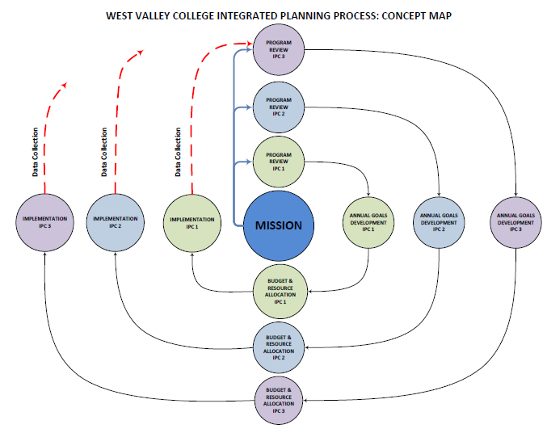
Getting Into the WVC Integrated Planning Orbit
This is what we had:
Notes:
Stephanie

Slide 20
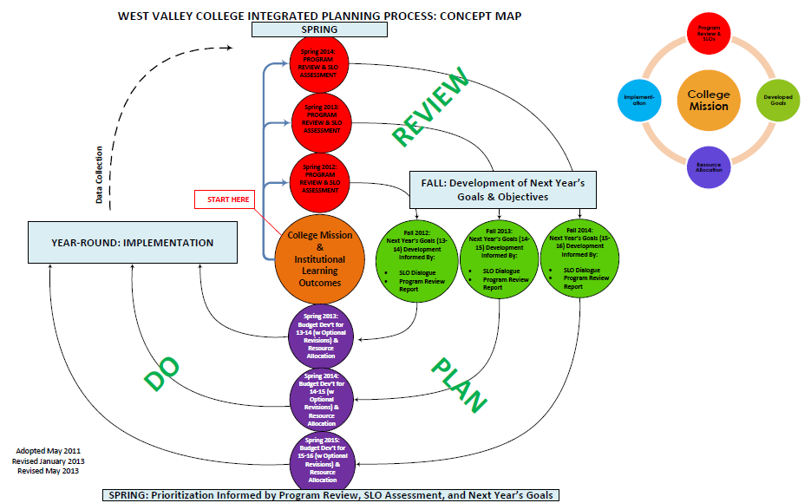
Getting Into the WVC Integrated Planning Orbit
This is where we are now:
Notes:
Stephanie

Slide 21
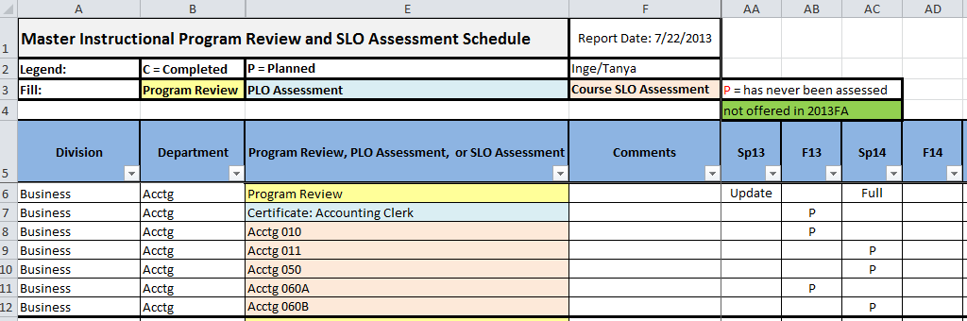
Preview: Master Instructional Program Review and SLO Assessment Schedule
Features:
  Filter by Division or Department
  Program Review, Degree, Certificate, and Course SLOs included
  Filter by term to see what is due
  Updated Fall and Spring
  Posted on SLO & A webpage
Notes:
Inge

Slide 22
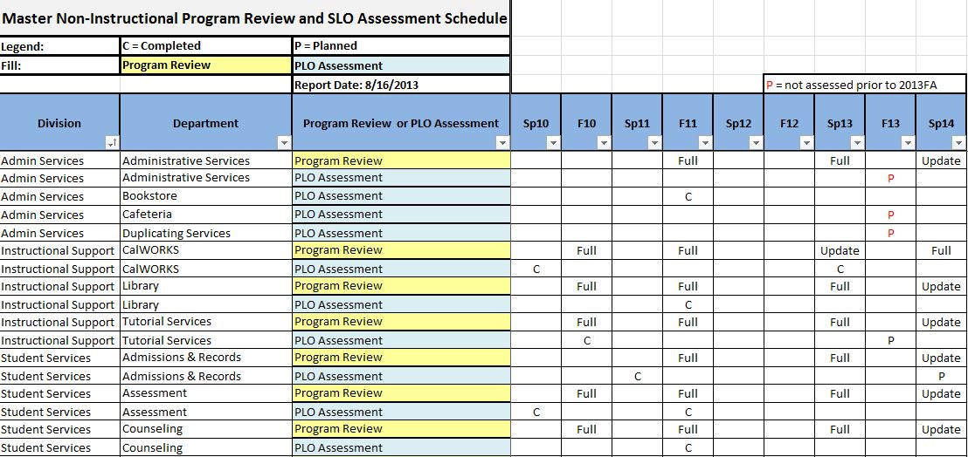
Preview: Master Non-Instructional Program Review and SLO Assessment Schedule
Features:
  Filter by Department
  Program Review and PLOs included
  Filter by term to see what is due
  Updated Fall and Spring
  Posted on SLO & A webpage
Notes:
Inge

Slide 23
Integrated Planning: Looking Ahead 2013-14
SLO Assessment & Program Review will inform budget planning and development
Master Program Review and SLO Assessment Schedule creates simple, consistent information source
Program Review, SLO Assessment, and Budget Development will have a common planning period: February through April 2014
All integrated planning information will be accessible via the Accreditation page on the college website
Notes:
Stephanie

Slide 24



Thank you!
Heidi Diamond
Michelle Donohue-Mendoza
SLO & A Committee Chairs
Inge Bond
Director of Institutional Research
and Planning
John Hannigan
Program Review Committee Chair
Kuni Hay
Vice President of Instruction
Lisa Kalenda
Accreditation Editor
Stephanie Kashima
Dean of Instruction and Student Success
Pat Fenton
VP of Administrative Services
Matthew Diamond
Business Division Intern
Notes:
Kuni

