Slide 1

WVC EMP College
Survey Results
December 3, 2020

Slide 2

Discussion Questions
What was the biggest surprise to you in these results?
What were your most compelling “take-aways” from these results?

Slide 3
Respondent Breakdown
Students | 783
Faculty (FT) | 90
Faculty (PT) | 30
Classified (FT) | 51
Classified (PT) | 12
Admin/Managers | 21
TOTAL | 987

Slide 4
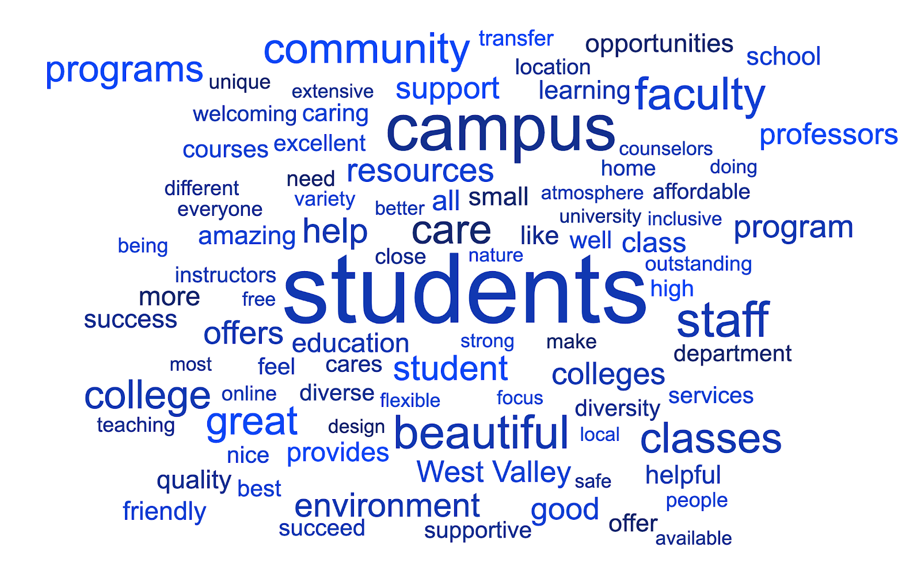
Please finish this sentence: West Valley College stands out from other colleges because... (There were more than 800 responses)

Slide 5
Student Questions

Slide 14
Other - Examples
This class, Effective writing, was not offered at West Valley College at Summer Semester.
Wanted to live somewhere else
That was my first college before deciding I didn’t like being there.
I went to train with the foothill soccer team
I was finishing my Bachelor's Degree.
Computer Science degree available
Did not like the professor that teaches this subject
Was an accounting major and those classes weren’t offered at WVC. But I’m a fashion major now so good riddance De Anza.
because It convinced for me to do online and its on my own time
Failed one class too many times and it is last requirement before I can transfer.
I’m only at West Valley College because De Anza wasn’t offering the classes I needed.
I attend Five Branches University primarily. However, sometimes I could not get into a class at west valley so I took that elsewhere.
Different major and I went straight out of high school

Slide 15
Faculty, Staff, Administrator Questions

Slide 20
All Respondents

Slide 21
Select the top 5 areas that you believe are the greatest strengths of the College? (Select 5)
Student Responses | #
Helpfulness of staff and support | 230
Online learning technology (Canvas) | 228
Availability of classes | 226
Ease of registration/enrollment | 193
Welcoming and well-maintained appearance of campus | 182
Student services | 176
Counseling services | 171
Faculty support | 150
Online student support services | 131
College website | 126
Non-Student Responses | #
Welcoming and well-maintained appearance of campus | 90
Helpfulness of staff and support | 80
Faculty expertise | 67
Student services | 62
Fellow students and colleagues | 55
Faculty support | 40
Online learning technology (Canvas) | 36
Tutoring services | 34
Counseling services | 32
Parking | 28

Slide 22
Select the top 5 areas that you believe are in need of improvement at the College? (Select 5)
Student Responses | #
Strategies to ease high cost of textbooks | 177
Availability of classes | 168
Parking | 155
College website | 122
Student gathering spaces (online) | 108
Online learning technology (Canvas) | 107
Ease of registration/enrollment | 107
Career technical programs that prepare students for growing job markets | 101
Online student support services | 96
Counseling | 95
Non-Student Responses | #
Ease of registration/enrollment | 62
Strategies to ease high cost of textbooks | 50
Career technical programs that prepare students for growing job markets | 50
College website | 47
Student access to technology | 47
Counseling | 46
Classroom technology | 43
Availability of classes | 37
Faculty support | 32
Student collaborative work spaces | 27

Slide 24
Question 33: Please list any academic programs or courses that are not currently offered at the College that you would like to see added.
This open-ended question elicited hundreds of varied suggestions, from Arabic to Wildlife Rescue, without any specific program getting at least 15 responses. The most frequent responses were in the areas of
  Business
  Computers/IT
  Health sciences
  Engineering
  Ethnic Studies
  Design

Slide 25
Question 34: Please list any student services programs or resources that are not currently offered at the College that you would like to see added.
This question drew about a hundred different responses. The most frequent responses were
  Mentoring
  Internships
  More support for undocumented students
  More food support
  Housing support
  Increased counseling/career guidance
  More online/technology support
  More tutoring

Slide 26
Question 37: What do you think is the single most critical consideration for the College planning committee as it plans for success of the College and its students for the next 5-10 years?
There were more than 400 unduplicated responses to this question. Among the more frequent responses were
Accessibility
Anti-racism, social justice, and equity plans
Enhance online education, even in the post-COVID time
Clear educational paths to achieve students’ intended career goals
Link courses and programs better with viable jobs and careers
Meet workforce needs
Give more attention to CTE programs that lead to jobs
Enhance mental well-being
Better communication
Respond better to the current COVID situation and plan for the post-COVID world
Continue to improve technology
Keep the welcoming environment of the campus
Find ways to engage students more

Slide 27
Discussion Questions
What was the biggest surprise to you in these results?
What were your most compelling “take-aways” from these results?
What are you curious about?

