Slide 1

WVC Program Advisory Committee Survey
December 3, 2020

Slide 2
Respondent Summary
Response Rate: 31% (46 of 150)
Distribution: 13 of the 14 committees were represented
Short, moderate, and lengthy service on committees all represented

Slide 6
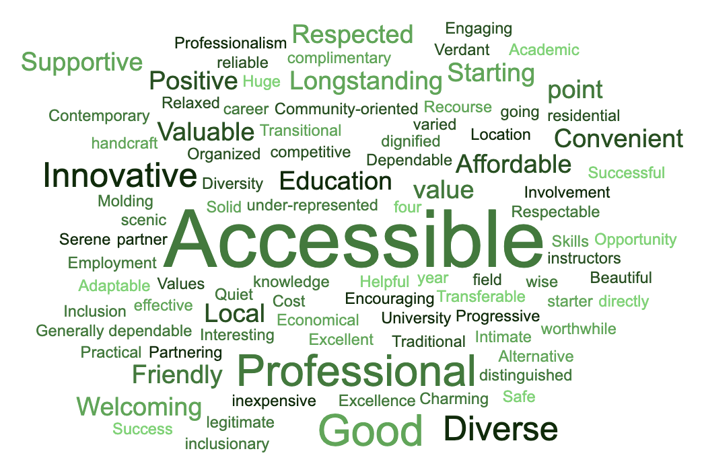
Please list 3 words that describe West Valley College's image in the community

Slide 8
Q6: WVC Image and General Reputation
51 varied responses, including
Affordable, close to home
Good programs, good instructors
Open to younger and older students
Valuable resource to the community
Bureaucratic, slow to respond & change

Slide 10
Q8: New Jobs to Explore for WVC Programs
49 responses, including
Additional health fields (emergency services, patient care, surg tech)
Entrepreneurship, change management, organizational design
Remote product development & production
Sustainability, renewable energy
Globalization, diversity, equity

Slide 11
Q9: Quality & Effectiveness of Programs
43 responses, including
Develop new, improved, up-to-date courses
More community outreach
More experiential, project-based learning
More hands-on experience
Continue to link curriculum with current job requirements

Slide 13
Q11: Prospective Student Populations
20 responses, including
Underserved groups, including African-Americans, Latinx, women re-entering the workforce
Public school aides, paraprofessionals
More outreach to high school students
Create a brand for students to identify with
More flexible scheduling for working persons

Slide 14
Q12 Teaching, Learning, Recruitment, Support
9 additional comments, including
Target the younger generation, what appeals to them
Add more outreach workers with enthusiasm for WVC
Help people in the workforce, intimidated about college, apply to WVC
Provide more places for students to turn for help

Slide 16
Q14: Other Info Helpful for PAC Members
25 responses, including
Survey of what businesses need & are looking for
How many students were employed before they graduated
More relevant discussions, not the same things every year
Where is the department not succeeding
How do students feel about the program they’re in

Slide 17
Q15: Additional Comments about PAC
17 responses, including
I like knowing our suggestions were put into practice
Good meetings with specific outcomes
Look more at what is working, what needs change
Use members more to inspire students
Being on the committee is the only engagement I have with WVC

Slide 18
Q16: Most Proud about WVC
32 responses, including
Excellent instructors, warm friendly people
How we try to get students into the workforce
How the court reporting program provided a career for 13 years for me, a person with a disability
Respected in the community
Ability to pivot to meet industry needs
The “grit” WVC students have

Slide 19
Q17: Future Trends with Most Impact
30 responses, including
Continuing increase in online learning
Keeping up to date with advancing technology
Increasing dependence on social media to recruit
Including more equity and diversity in program design
Increasing need for affordable college education

Slide 20
Q18: Actions to Better Serve Community
22 responses, including
More outreach earlier to underserved high school students
Offer new classes quickly, with rapid prototyping delivery
Explore variety of jobs open to program graduates
More real-work project-based learning
Publish more stories about successful students

Slide 21
Discussion
  What was the biggest surprise to you in these results?
  What were your most compelling "take-aways" from these results?

