Slide 1

How to Write a Business Plan
Or at least a few things to think about while you do

Slide 2

a lightweight, reusable sandbag; an earth-friendly alternative to human composting; leggings for men; toasty, ready-to-eat Latin American foods
a bot service for consumers; frozen beef Wellingtons; a baseball glove wrapper; a dating advice service.
A portable outdoor game that combines pickleball and Spikeball; a pet-sitting service for weddings and events; a high-fashion bodysuit; gourmet made-to-order French fries.

Slide 3




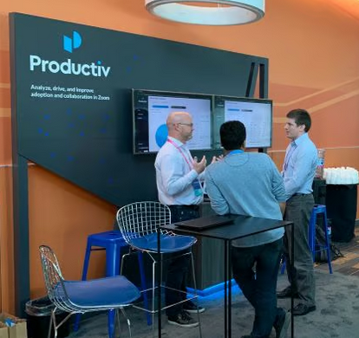
Nuvia, Wing, Productiv, Step Netdata, Fiddler Labs, Confluera, Dusty Robotics, Hourly, Arc
https://www.builtinsf.com/articles/silicon-valley-startups

Slide 4

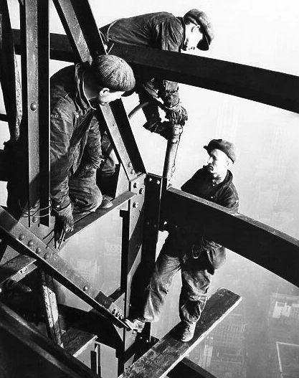
Yourself: to cause thoughtful, comprehensive and realistic assessment of your ideas
Plan
action
Investors: to show serious thought, understanding and clarity, especially regarding your product, competitive advantage, people and profitability (growth)
Other Stakeholders: to capture the mission and message so that they can understand and amplify the key values and messages of the business

Slide 5

Before You Start
1
2
3
Can you explain who your customer is and why they need what you have? (and how your answer is better than the competition)
Realistically, what will it take, especially the people, and do you have a clear plan regarding how you make a profit?
Have you talked to actual (or potential) customers? What did you learn?

Slide 6
Elements of the Business Plan
Executive Summary the short story in one page
Company Description the mission, structure and key staff
Market Analysis who is our customer and how many are there
Product and Services what we have and why its better
Marketing and Sales Plan how we find customers and convince them to buy
Financials our plan in numbers
Funding Request and what we’ll do with it

Slide 7
Executive Summary
Hook, product/service, market analysis and competitive advantage, financials, future plans, funding request (one paragraph each)
What percent of your software did your team actually write? 90%? 100%? The answer is maybe 20%. Software today typically contains 70-90% code that your team didn’t write, mostly open source downloaded from the internet. That’s great for productivity, but not so great when it comes to issues of ownership and security. How can you deliver secure code if you don’t know what’s in it? For example, the open source component OpenSSL is widely used. A few years ago, a security flaw allowed unprotected access to over 300,000 public web servers. Our product is the first to automate the process of identifying open source code and flagging security and ownership issues.

Slide 8
Executive Summary
Hook, product/service, market analysis and competitive advantage, financials, future plans, funding request (one paragraph each)
Our patented massive multi-pattern search algorithm allows our system to search gigabytes of software and return results more quickly than any other technique, saving time and money and creating more secure software

Slide 9
Company Description
Mission statement, management team and resumes, product and services overview, workplace, legal structure
We will establish a new category of software, Software Composition Analysis (SCA), which will be an essential part of every software development process. Companies employing SCA will develop more secure applications with greatly reduced risk of intellectual property and vulnerability issues. Our unique blend of technology and expertise in open source software provides a sustainable advantage will allow us to achieve revenues of $50M within three years.

Slide 10
Company Description
Mission statement, management team and resumes, product and services overview, workplace, legal structure,
Our co-founder and chief technical officer has been a visible contributor to open source projects, and was responsible for open source security at NASA Ames. In this role he defined processes and tools to ensure the security of NASA software and became a leading spokesperson for Software Composition Analysis.

Slide 11
Market Analysis
Industry overview, target customer, addressable market, competition
Our addressable market is commercial software companies of which there are over 500,000 in the US alone and over 750,000 worldwide. Initially, our target is the 1000 largest software companies in the US, since they have the most highly developed awareness of the problem and the resources to apply to a solution. Our initial point of contact is via one of two individuals, the director of intellectual property within the legal team, or director of software security within the development organization. These individuals have the responsibility to ensure that the software their organization develops is free from security or intellectual property issues as a result of open source use which would restrict their ability to sell the product or create substantial customer issues.

Slide 12
Market Analysis
Industry overview, target customer, addressable market, competition
Since this is a new category, there are no direct competitors, although we expect competitors to emerge over time. The largest barrier is awareness of the issue, and where there is awareness, manual internal processes. Our product is much faster and more accurate than manual processes, so our competitive challenge is to create awareness within our target customers and establish an entry point that allows customers to move forward with our solution.

Slide 13
Product and Services
Product description and demo, value proposition, pricing, competitive advantage, customer stories (wins or feedback)
Our product is a software application that enables rapid and accurate identification of open source code within a customer’s software, and provides alerts regarding potential security and ownership (licensing) issues. Our product is designed to support a software as a service use model, or alternatively to be deployed on a customer site if required for confidentiality reasons. We have also established a services team that will use our product for turnkey scan and analysis of customer code. This provides a low barrier to entry first step toward use of our product as well as continuous improvement in the breadth and quality of our library of open source component information. Let's look at the demo.

Slide 14
Product and Services
Product description and demo, value proposition, pricing, competitive advantage, customer stories (wins or feedback)
Our competitive advantage is speed and accuracy vs manual analysis techniques, and the ability to analyze both binary and source code. While system tools such as ‘grep’ can match text, such tools would need to be paired with a comprehensive library of open source components to equal our capability. Our library consists of information on almost 500,000 components, allowing our analysis to be much more comprehensive and accurate than any other technique.

Slide 15
Marketing and Sales Plan
Lead generation and awareness, sales and distribution
Our lead generation program will prioritize our web site and social media. Due to our co-founder’s role as a leading advocate, we will build on his social media presence. In addition, we will post extensively on youtube, attend selected trade shows, author white papers and cultivate industry analysts.
We will initially develop a small team of direct sales and system engineers to win our early customers. We will develop a services team in order to offer our product as a service and form the basis for a software as a service business as we expand.

Slide 16
Financials
Brief narrative, Profit and loss statement (P&L) – monthly for one year then 5 year forecast, balance sheet, cash flow
Our seed funding was provided by the company founders and was sufficient to allow development of a beta version of the product. The financial plan presented here assumes outside funding for the next stage of growth in order to begin marketing and sales activity and complete initial R&D hiring. We have commitments for first year sales of $1M and expect to finish the year at $2M. Years 2 and 3 are forecast at $4M and $8M respectively with profitability in year 3. Are there any questions regarding the financial statements?

Slide 17
Funding Request
Proposed amount, debt or equity, uses, timing
We are seeking $5M in equity funding for a 30 percent post money ownership of the company. We plan to use this amount to build our sales and marketing team and expand our development team to add coverage for new languages and to expand to feature set to support our product as a service offering.

Slide 18
The goal is to be a roadmap for action, not to be a perfect document
It is a living document. Keep it updated
Make it easy to read. Bullet points, charts and pictures. You’ll need a text and preso version. Know your audience.
Practice, get feedback, revise …
Things take longer than you think, so get started

Slide 19
How to Write a Business Plan
Or at least a few things to think about while you do

