Slide 1
Patent Basics: Demystifying the patent process
Brent Fairbanks
Primary Examiner, Assistant Outreach Coordinator
October 11, 2023
Notes:
I am a primary examiner specializing in sensors, particularly “how full is your battery?”.

Slide 2
Notice
This content is for informational purposes only and is not legal advice. Please consult with appropriate sources for legal authority and guidance on these matters.

Slide 3

Outline
Background
History
Importance and types of patents
Patent roadmap
Anatomy of a patent
Careers
Examiner skill set
Job description
Patent application journey
Role of the USPTO

Slide 4
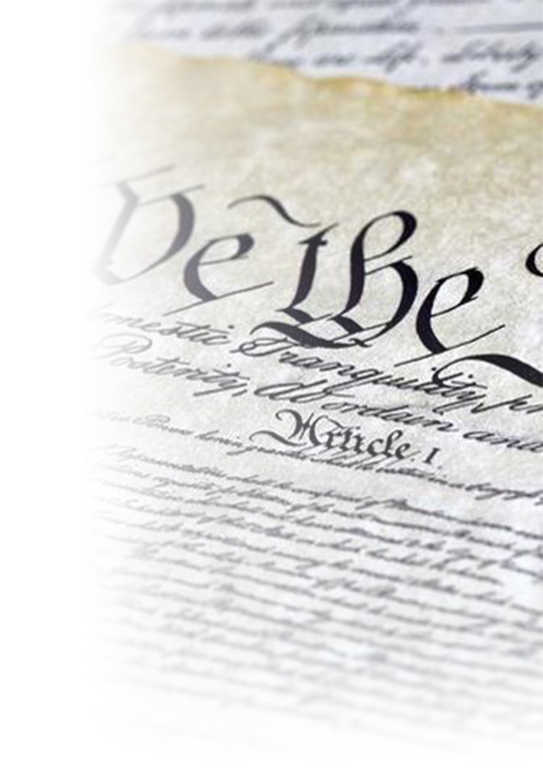
Historical foundation of intellectual property
Intellectual property (IP) is deeply rooted in our nation’s history.
  U.S. constitution Article 1, Section 8, Clause 8:
  “The Congress shall have Power … to promote
  the Progress of Science and useful Arts, by securing for limited Times to Authors and Inventors the exclusive Right to their
  respective Writings and Discoveries … ”

Slide 5

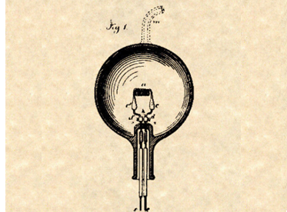
What is intellectual property?
Real property
Intellectual property
Notes:
So what is intellectual property?
Intangible property that are creations of the mind – intellect,
for example: inventions; literary and artistic works; designs; and symbols, names and images used in commerce.
Just like a fence defines the physical boundaries of property that belongs to you, intellectual property defines the metes and bounds, or the “legal fence” around an intangible property, like an idea.
The legal ownership of intellectual property allows its owner to exclude other people from using the ideas or concepts that comprise the intellectual property at issue.

Slide 6









Types of intellectual property
®
©
Patent
Trademark
Copyright
Trade secret
New, inventive ideas
Identifies the origin of goods or services
Creative expression stored in a tangible form
Any information that is valuable & kept confidential

Slide 7
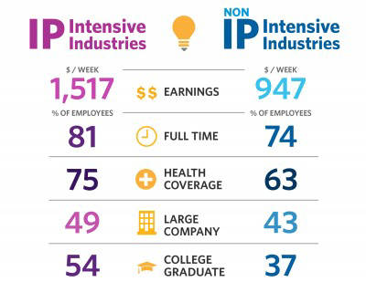
IP industries vs. non-IP industries

Slide 8
IP and the U.S. Economy
63 million jobs
44% of all U.S. jobs were in IP Intensive Industries (2019)
~50%
IP Intensive Industries share of Total U.S. GDP (2019)
$1,517/week
(60% higher)
Avg. weekly wages for workers in IP-intensive industries
$7.8 trillion
GDP contribution of IP-intensive industries (2019)
15.5 million
Industry jobs supplying intermediate goods and services (2019)
~33% of all jobs
>47M U.S. jobs supported by IP-intensive industries (2019)
Sources: Department of Commerce. 2016. “Intellectual Property and the U.S. Economy: 2016 Update”. September 26. www.uspto.gov/sites/default/files/documents/IPandtheUSEconomySept2016.pdf (January 3, 2018).
“Intellectual Property and the U.S. Economy: 2019 Update” (March 17, 2022)
www.uspto.gov/sites/default/files/documents/uspto-ip-us-economy-third-edition.pdf

Slide 9
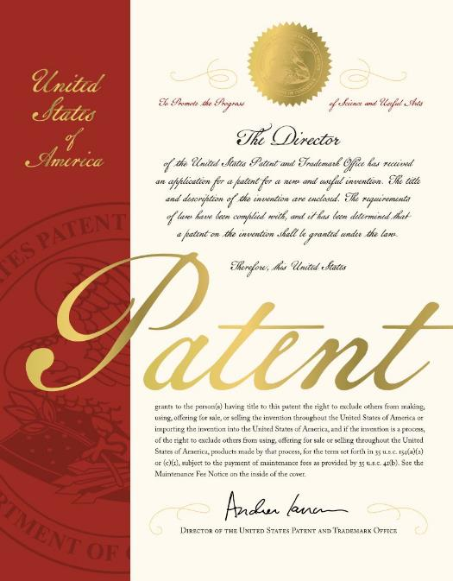
Patent

Slide 10

What is a patent?
A property right to exclude others from making, using, selling, offering for sale, or importing the claimed invention
Limited term
Territorial: U.S. patent provides protection only in the United States
  No worldwide patents
Notes:
So what exactly is a patent and what does it do for you? Well, a patent gives you the legal right to exclude others from making, using, selling, or importing your claimed invention. You have this right for a limited term, which I’ll go over in a minute, because it varies based on which type of patent you apply for. You should also keep in mind that a patent filed in a specific country provides protection for that respective country only, as there are no quote “worldwide” patents. However there is a specific treaty, the Patent Cooperation Treaty, or a PCT, which allows applicants to simultaneously seek protection for an invention in a large number of countries, which I believe that to be 156 different countries.

Slide 11
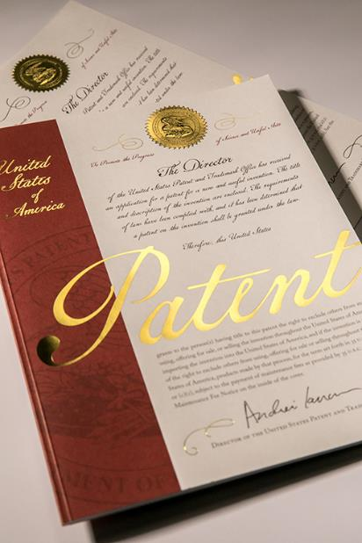
What is a patent?
A U.S. patent is
A property right granted by the United States government to an inventor
To exclude others from making, using, offering for sale, or selling the invention throughout the United States or importing the invention into the United States
For a limited time
In exchange for public disclosure of the invention

Slide 12

Who can be an inventor on a patent?
Anyone who contributes to the conception of an invention
  Alone, or in combination
  with others

Slide 13


Why invention matters and what this means to you
Patents can:
Promote innovation and help safeguard your inventions
Help companies grow
Benefit the community by making
new goods and services available
Provide personal growth, development, and advancement

Slide 14
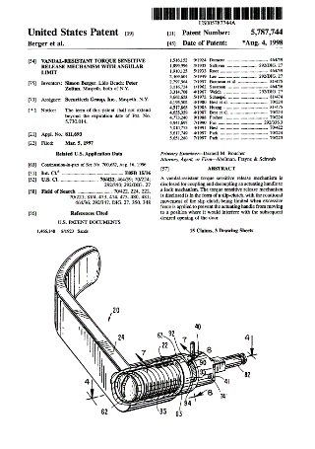
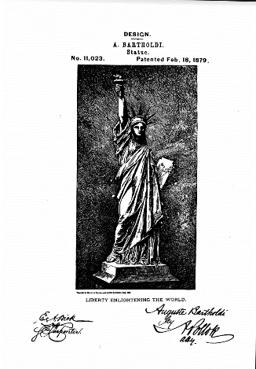

Types of patents
Utility
New and useful process, machine, article of manufacture, or composition of matter, or any new and useful improvement thereof
Design
New, original and ornamental design; protects the way an object appears
Plant
New and distinct, invented or discovered asexually reproduced plant
Notes:
Asexual reproduction: bulbs (tulip, daffodil), corms (garlic), runners (strawberry), tubers (potato), leaf cuttings

Slide 15
US and State patent grants

Slide 16
Patent Types by California Inventors
* July 2020 - July 2023

Slide 17

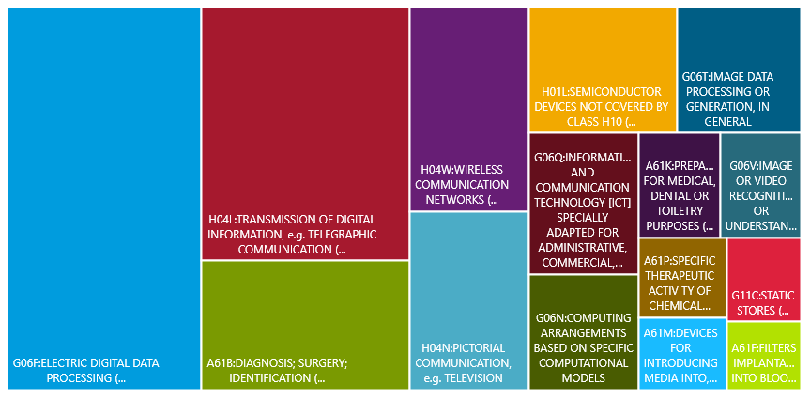






Top 15 classifications by California Inventors
* July 2020 - July 2023

Slide 18

The patent application journey
First, you need an idea!
  Is your idea worth protecting?
Present your idea
Draft application
File application
Step 1
Step 2
Step 3
Step 4

Slide 19


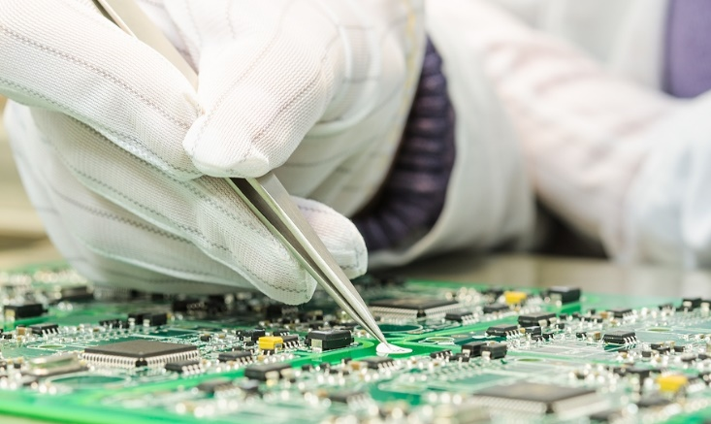

Is your idea eligible for protection?
process
machine
manufacture
composition of matter
35 U.S.C. § 101

Slide 20
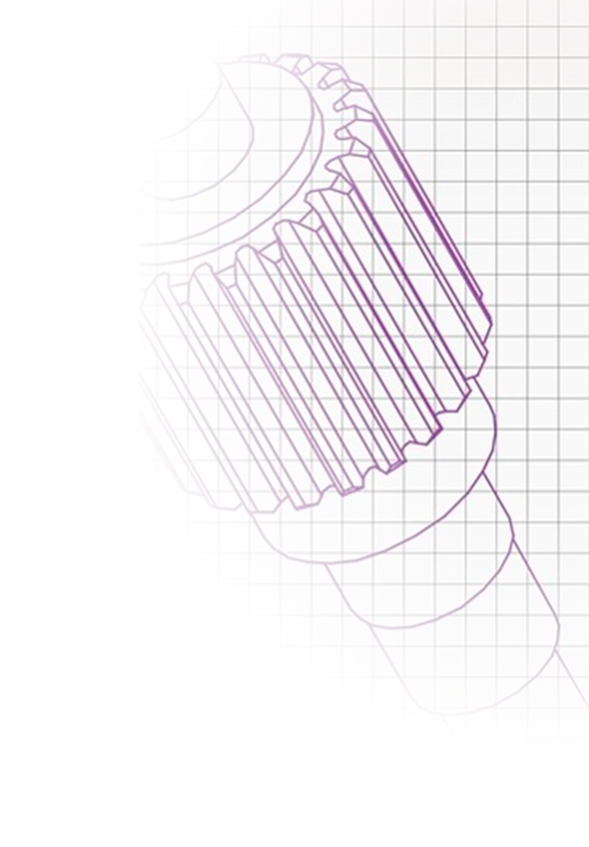
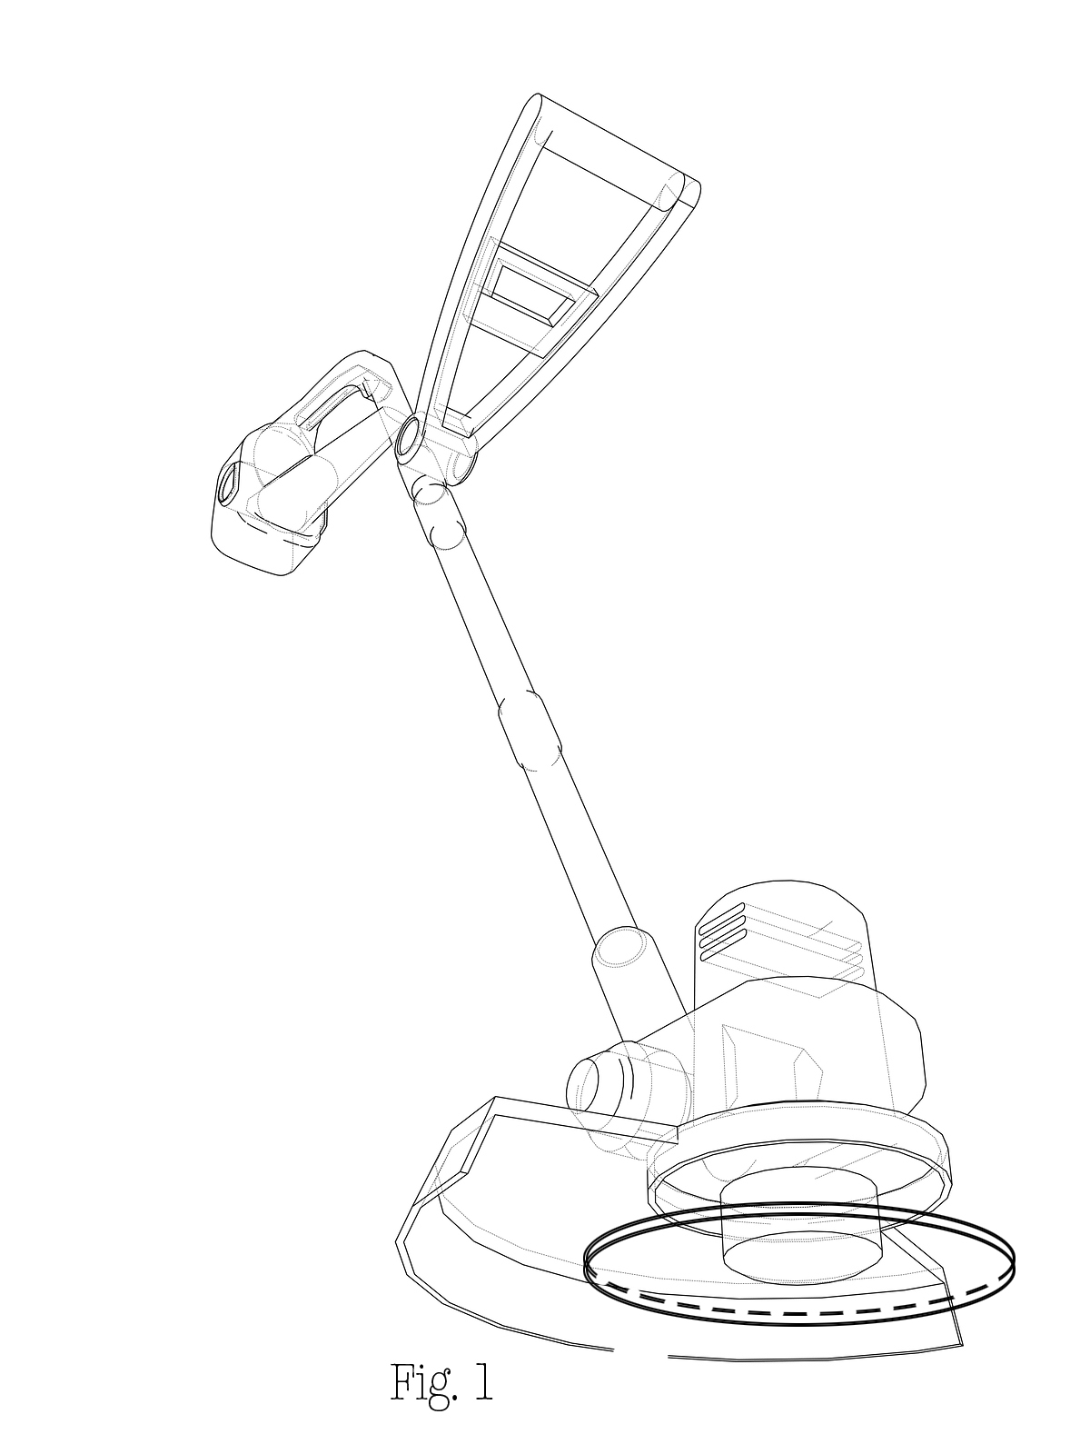
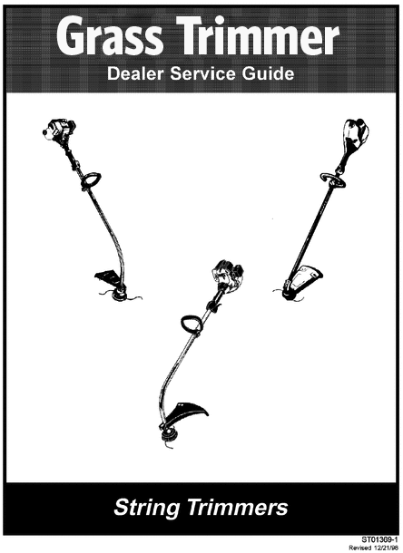
Is your idea novel and non-obvious?
“Novel”: e.g., your invention is new, was not described in the prior art
“Non-obvious”: e.g., the differences between your invention and prior art would not have been obvious to someone in that field
Your invention
Prior art
35 U.S.C. §§ 102 and103

Slide 21


What is prior art?
Prior art includes:
patents,
printed publications,
other disclosures in the field of your invention that have been published before your effective filing date.

Slide 22

The patent application journey Step 1
First, you need an idea!
Present your idea
  Maintain confidentiality.
Draft application
File application
Step 1
Step 2
Step 3
Step 4

Slide 23
Presenting your idea
Don’t be afraid to champion your idea.
  Diagrams are helpful.
Best to maintain confidentiality prior to filing your patent application.
Consult with counsel about safe ways to disclose your invention before filing a
patent application.

Slide 24

The patent application journey Step 3
First, you need an idea!
Present your idea
Draft application
  It’s now time to write up
  the patent application.
File application
Step 1
Step 2
Step 3
Step 4

Slide 25
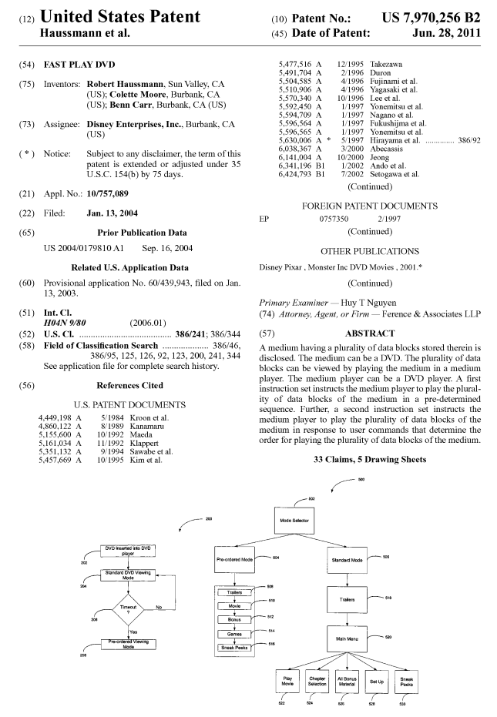
Anatomy of a patent
Issue date
Abstract
  A short summary of the invention.
Written description
  How does it work?
  How is it made or used?
Drawings
  What does it look like?
Claims
  Define(s) the legal boundaries of the invention
  similar to a deed to a property
Invention title
Your name
Filing date
Prior art
Drawings
Abstract

Slide 26
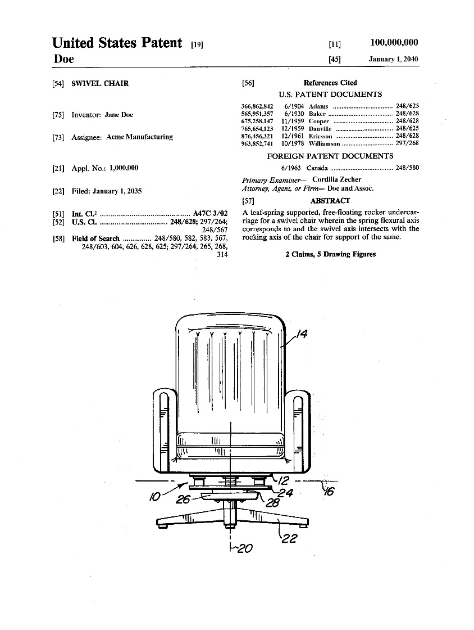
Sample claim
Claim 1. A chair comprising:
  a seat,
  a back support attached to the seat,
  support arms attached to the seat and back support, and
  a base comprising a plurality of legs attached to the seat.
Notes:
So I just talked about the “claimed invention”, and here’s an example I want to walk through to explain that. This is what a claim looks like, where we start here (click) with the preamble. The preamble tells us what the device is in general, and its followed by the actual structure of the invention. So the chair includes (click) a seat, (click) a back support, which is attached to (click) the seat. And as we continue down the claim (click until seat), more and more structure is added into the claim language, until you finally have the structure of the chair. One thing to note about the way the claim is written, is that anytime a new element is introduced for the first time, you can see the word “a” preceding the element, and anytime the element is referred back to, you have the word “the”. So here we have A seat, A back support, A base, and A plurality of legs, but then after its introduced, we have THE seat, THE BACK SUPPORT. So why is that? Well, this is something we refer to as establishing antecedent basis, so if a new element is introduced with the word “the”, and no antecedent basis has been established, then the claim becomes unclear. Here we have the structure first expanded by relation to the seat, then expanded by elements in relation to the seat and back support, so it helps keep the claim clear. Claim 1 is an independent claim, because it does not call back to any other claim. However, you can add more structure through dependent claims to further narrow your invention. A sample dependent claim could read: The chair OF claim 1, further comprising a swivel mechanism, wherein the swivel mechanism includes dot dot dot”. And then that in turn could have another dependent claim where the next claim goes more in depth about the structure of the swivel mechanism.

Slide 27
What do I need to disclose?
A patent is a quid pro quo:
In exchange for
  The right to exclude others from making,
  using, importing, or selling your invention
  for a limited time period,
You must fully disclose your invention so the public can benefit from it and expand on it.
35 U.S.C. § 112

Slide 28
What do I need to disclose?
Does the disclosure:
Demonstrate that the inventor was in possession of the claimed invention?
Teach one of ordinary skill to make and use the invention without undue experimentation?
Describe the best mode contemplated for carrying out the invention by the inventor?
35 U.S.C. § 112 (a)

Slide 29
What do I need to disclose?
Are the claims clear enough that:
The public is informed of the boundaries of your invention?
It can be determined whether the claimed invention meets all the criteria for patentability?
35 U.S.C. § 112 (b)

Slide 30

The patent application journey Step 4
First, you need an idea!
Present your idea
Draft application
File application
  The application is filed with the USPTO. You will need to file a sworn oath or declaration that you invented the invention described in the application.
Step 1
Step 2
Step 3
Step 4

Slide 31
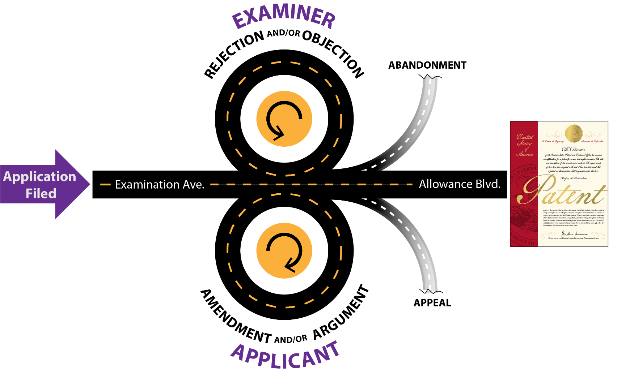
The patent application roadmap
Back and forth with the USPTO

Slide 32




Role of the USPTO examiner
Read and understand
the application
Search for prior art
Evaluate the specification
and claim(s)
Respond by office action(s)
describing findings
Hold interviews, as requested

Slide 33



Role of the applicant
File a complete application
Disclose all known prior art
In response to examiner
office actions:
  Explain your position, and/or
  Make good faith changes
  to the application

Slide 34
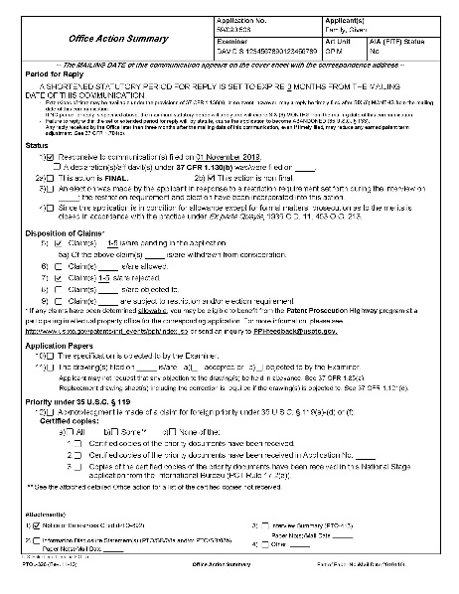
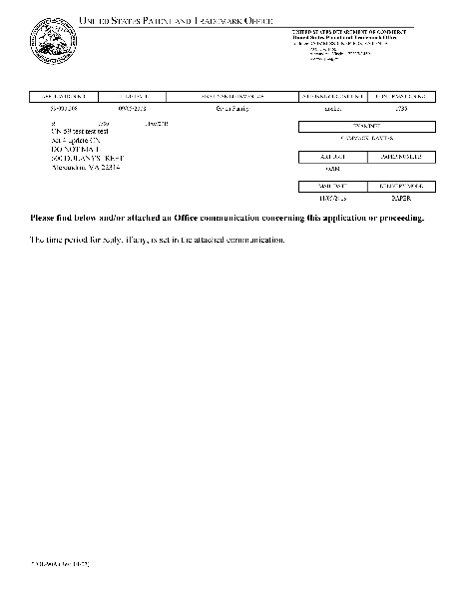
What is a
USPTO office action?
An office action sets forth the basis for any objections, rejections, and allowability

Slide 35
What does a rejection mean?
Rejections are a normal
part of the process
They help define what is patentable
Often due to existing prior art
  The examiner must have a basis to believe someone else may have come up with what you invented before you
Can often be overcome

Slide 36
Receive a rejection? Don’t give up!
Fact: In FY 2019, 84% of original filings received a first office action containing a rejection.
Fact: In FY 2019, 58% of examiner disposals were allowances.

Slide 37


Power of the interview
Notes:
By end of 2020, 38% of applications had at least 1 interview. https://www.uspto.gov/blog/director/entry/interview-practice-and-its-importance

Slide 38
After-final practice
Even if you receive a final rejection, don’t panic. If you still disagree, you may still have options:
  Request for continued examination (RCE),
  Appeal, or
  After-final response

Slide 39
Typical processing timeline*
Months

Slide 40

Allowance and issuance
A notice of allowance indicates all objections and rejections have been overcome and your application is ready for issuance.
Congratulations!

Slide 41

Remember
Stay involved throughout the process.

Slide 42
Becoming a Patent Examiner
As of 01/01/2020

Slide 43

The USPTO is America’s innovation agency
Committed to:
Fostering innovation and
economic growth
Creating a reliable, predictable, and high-quality IP system

Slide 44
USPTO’s mission
Foster innovation, competitiveness, and job growth in the United States
Conduct high quality and timely patent and
trademark examination
Produce reliable and predictable intellectual property rights
Improve intellectual property rights protection
Deliver intellectual property information
and education worldwide

Slide 45
Guiding principles
Through a culture of quality, we promote excellence throughout the organization by valuing accurate and consistent results, primarily in the examination processes.
Through timeliness, we recognize the needs of our customers and stakeholders to have our products and services delivered at a time that meets their individual needs.
Through efficiency, we are sound financial stewards of the user fees paid by our customers, and we use the lowest number of inputs to create the greatest number of outputs, maximizing results.
Through effectiveness, we listen to our customers and stakeholders, and incorporate their feedback.
Through accountability, we measure our activities, accept responsibility for them, and disclose the results in a transparent manner.
Notes:
Regional office improve these factors by being close to our stake holders

Slide 46

Year after year, USPTO is voted as…

Slide 47
Employment requirements
U.S. citizenship or national
Technical degree
Worksite located in the 50 United States, Washington DC, or Puerto Rico
47
Notes:
UPDATE: image?
What are the requirements for a patent examiner position at the United States Patent and Trademark Office? There are three core requirements. First, the applicant must have a technical degree from an accredited college or university with a bachelor of sciences or higher. Second, the applicant must be a citizen of the United States. Third, the applicant must be willing to relocate to the Washington DC area. Also note that we might have positions open in our regional locations – please check USAJOBS.
For more information, contact the HR Specialist listed at the bottom of the announcement

Slide 48
Patent examiner skill set
Strong technical background
Analytical and research oriented
Able to make decisions
Able to independently manage time
Excellent written and oral communications skills
Attention to detail
Notes:
UPDATE: image?
Did you ever wonder what it takes to be a patent examiner? It requires a certain skill set to be successful. This slide highlights some of the skills such as good engineering common sense; enjoying practical application of current technology as opposed to merely theoretical; and enjoyment from making decisions and effectively articulating your reasoning.
The nature of patent examining creates an environment of constant learning for examiners throughout their careers at United States Patent and Trademark Office. In addition, the examiners are placed on a structured production requirement, making it possible to visualize the necessary steps to achieve promotion goals.
Do you think you have what it takes to be a patent examiner?

Slide 49

Desirable characteristics of a patent examiner
Collegial
Collaborative
Professional
Curious and Persistent
Continued improvement
Enjoys research
Enjoys writing
Takes pride in individual accomplishments
Notes:
Collegial – Be SMART and NICE

Slide 50
Benefits of being a patent examiner
Patent Training Academy and
in-house technical/legal training
Non-competitive promotions to GS-13
Reasonable Accommodations
Flexible work schedules
Optional overtime (dependent upon funding availability)
Telework opportunities
Competitive salary (special pay rate)
Training and Mentorship opportunities
(ex. Leadership Development Program)
Height-Adjustable Desks
Affinity Groups: Society of Women Engineers, National Society of Black Engineers, Society of Hispanic Professional Engineers, PTO Society, Asian-Pacific American Network, etc.
Annual and quarterly performance awards
Law School Tuition Reimbursement Program (dependent upon funding availability)
Advanced Technical Degree Tuition Reimbursement Program
Thrift Savings Program (TSP): Federal employee version of the 401K with up to 5% matching)
Pension annuity that vests after
5 years of service

Slide 51
USPTO Resources

Slide 52
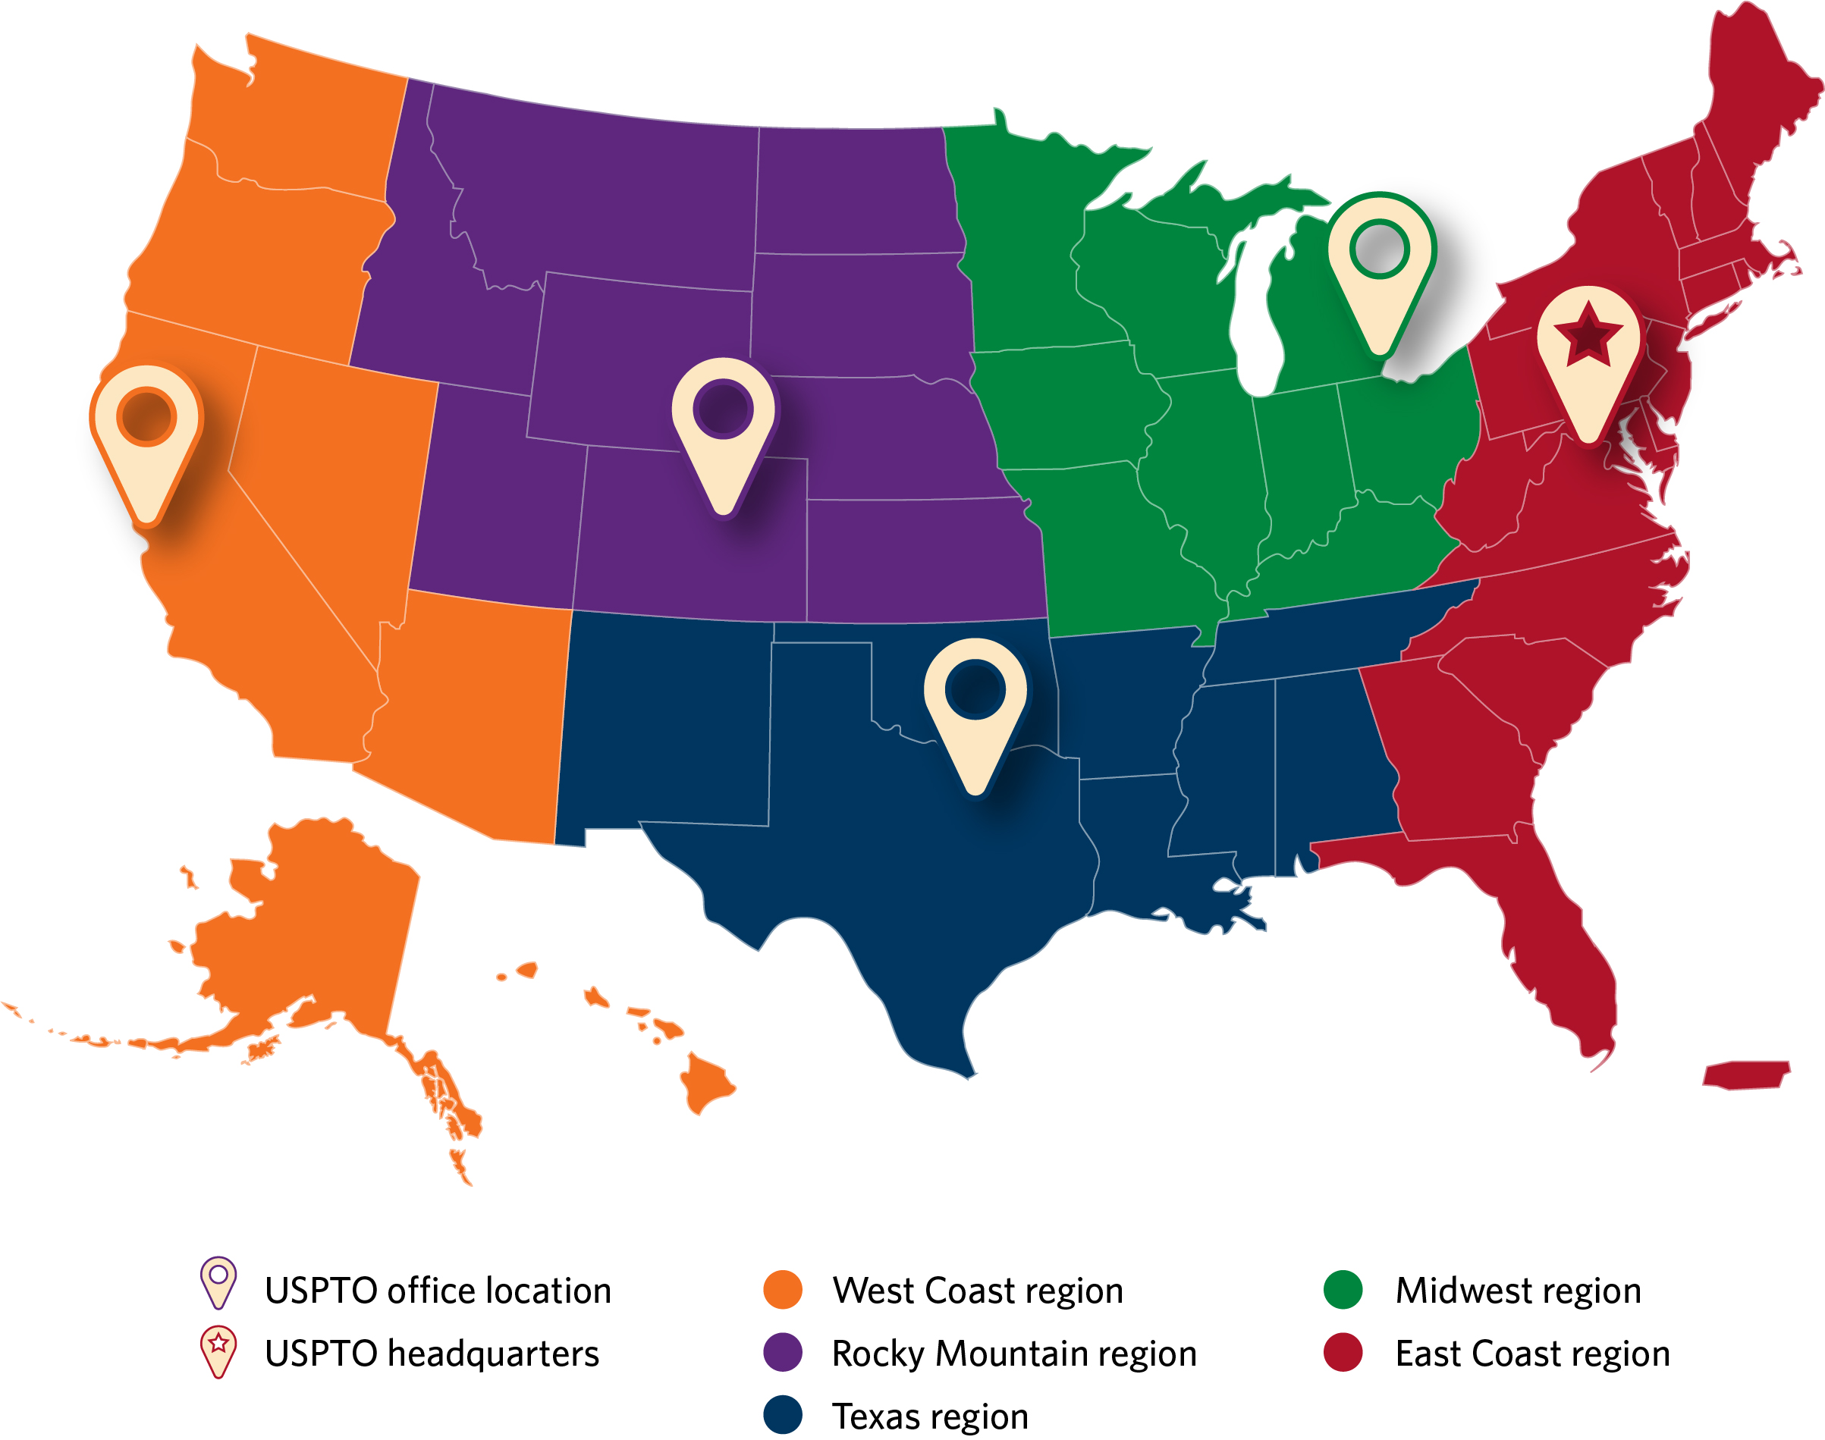
Find help in your area
USPTO offices:
  Headquarters:
  Alexandria, VA
  Regional offices:
  Detroit
  Denver
  Silicon Valley
  Dallas
Additional resources:
Inventors Assistance Center
Patent Pro Bono Program
Law school clinics
Patent and Trademark Resource Centers
uspto.gov

Slide 53
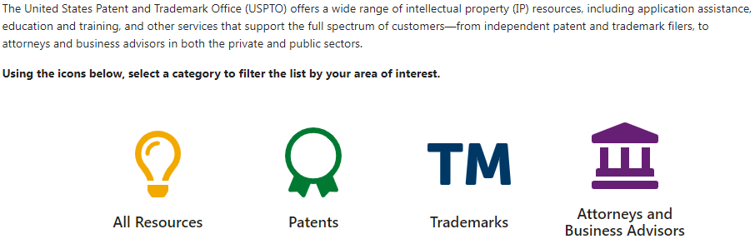
Access our free services
www.uspto.gov/learning-and-resources/access-our-free-services
Notes:
Use the web address in the slide because there does not appear to be a clear link to this site from the parent “Learning and Resources” page.

Slide 54

First-Time Filer Expedited Examination Pilot Program
This program is designed to encourage innovation for inventors who are new to the patent application process and is offered at no additional cost to the applicant.
Upon acceptance into the program, your patent application will receive special status:
Earlier first office action (a patent examiner’s written notice of findings)
Earlier indication of whether your invention is patentable
www.uspto.gov/FirstTimePatentFiler

Slide 55
First-Time Filer Expedited Examination Pilot Program
You may be eligible if you have:
Filed a utility nonprovisional patent application meeting certain guidelines
Not been named as an inventor on any other nonprovisional application
Filed your application electronically using Patent Center (in DOCX format)
Completed your application when filing for acceptance into the program
Qualified for special status based on income
Received reasonable training in the basics of the patent application process
To apply
File a “Petition to Make Special” (Form PTO/SB/464).

Slide 56
Inventors Assistance Center (IAC)
The Inventors Assistance Center (IAC) provides patent information and services to the public. The IAC is staffed by former supervisory patent examiners and experienced former primary examiners who answer general questions concerning patent examining policy and procedure.
Monday – Friday,
8:30 a.m. – 8 p.m. ET,
except federal holidays
800-PTO-9199
(800-786-9199)
571-272-1000
TTY customers can dial
800-877-8339 for
customer assistance

Slide 57
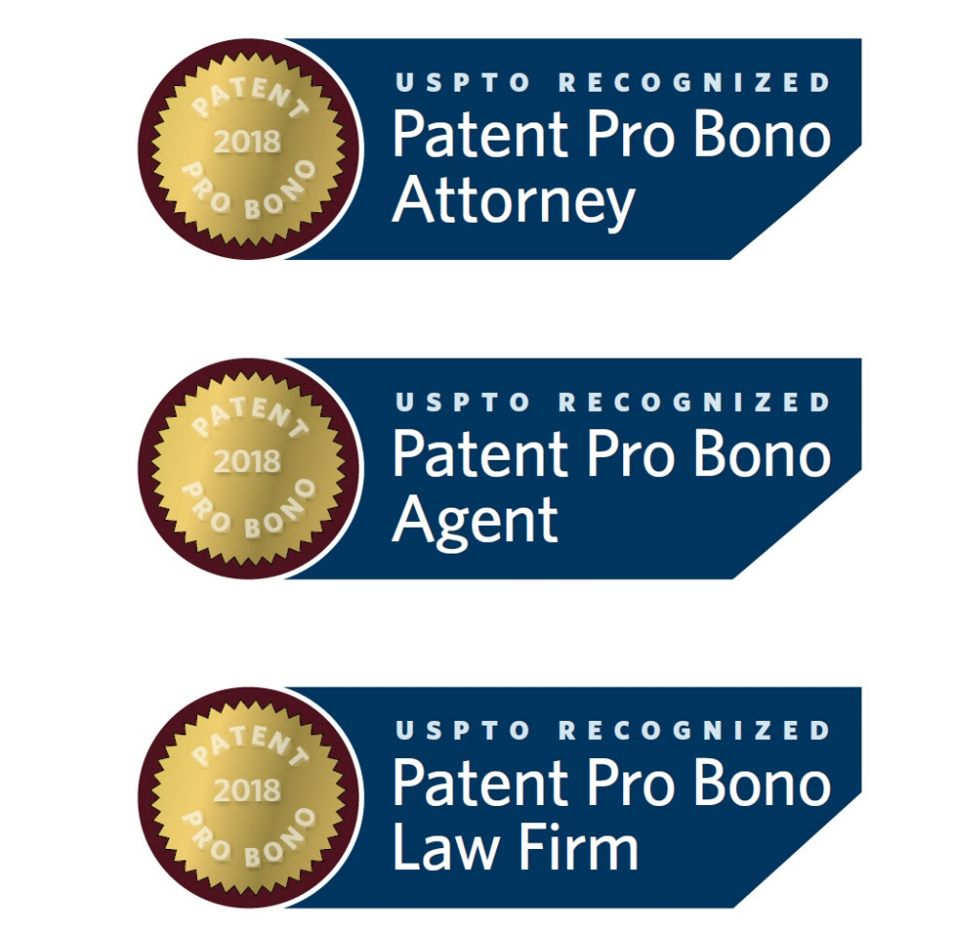
USPTO Patent Pro Bono Program
A nationwide network that assists financially under-resourced independent inventors and small businesses
Program participants must have income 300% below federal poverty guidelines
PATENT
PRO BONO
ATTORNEY
PATENT
PRO BONO
AGENT
PATENT
PRO BONO
LAW FIRM
For more information, visit www.uspto.gov/probonopatents.

Slide 58
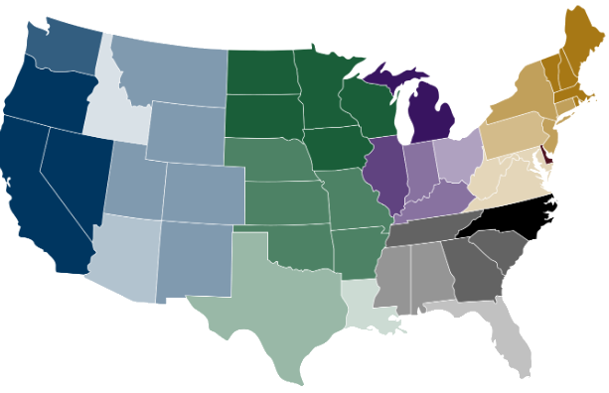

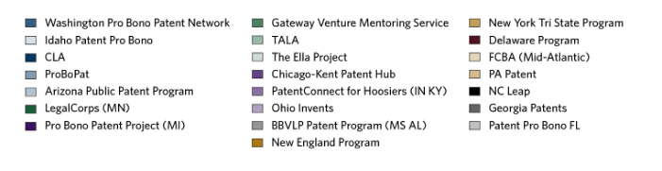
Pro Bono Program organizations

Slide 59

Law school clinics
The USPTO’s Law School Clinic Certification Program allows law students enrolled in a participating law school’s clinic program to practice before the USPTO under the guidance of a law school faculty clinic supervisor.
For more information, visit www.uspto.gov/lawschoolclinic.

Slide 60
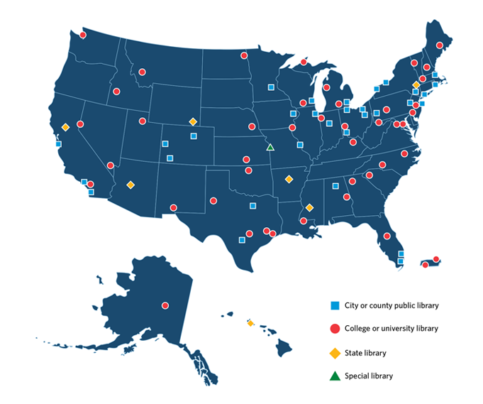
Patent and Trademark
Resource Centers (PTRC)
Nationwide network of public, state, and academic libraries designated by the USPTO to disseminate patent and trademark information and support the intellectual property needs of the public.
Phoenix PTRC
Located in the State of Arizona Research Library
https://azlibrary.gov/branches/state-arizona-research-library/patent-trademark-resources
For more information, visit www.uspto.gov/ptrc.

Slide 61
Other USPTO resources
Helpline: 1-800-PTO-9199
Resource | Website
Utility patent application guide | www.uspto.gov/patents/resources/types/utility.jsp
Patent process | www.uspto.gov/patents/process
Patent search guide | www.uspto.gov/patents/process/search
Inventor and entrepreneur resources | www.uspto.gov/inventors
Pro se assistance | www.uspto.gov/ProSePatents
Micro entity Information | www.uspto.gov/PatentMicroentity

Slide 62
Upcoming events
10/12: The Path to a Patent, Part I: IP basics
11:00 AM – 12:30 PM PT; virtual only
10/17: Trademarks Basics Boot Camp, Module 3: Searching
11:00 AM – 12:30 PM PT; virtual only
10/18: Women Entrepreneurs: Protect and promote your brand
9:00 AM – 10:00 AM PT; virtual and in-person at Evanston, IL
10/19: One-day patents boot camp
9:00 AM – 5:00 PM PT; in-person only at Sacramento Valley SBDC
10/19: The Path to a Patent, Part II: Drafting provisional patent applications
11:00 AM – 12:30 PM PT; virtual only
10/27: 2024 National Patent Application Drafting Competition overview
9:00 AM – 10:00 AM or 1:00 PM – 2:00 PM PT; virtual only
For a list of upcoming events, visit www.uspto.gov/events.

Slide 63
Thank You
Western Regional USPTO
SiliconValley@USPTO.GOV
(408) 918-9900
www.uspto.gov/SiliconValley
www.facebook.com/uspto.gov
www.youtube.com/USPTOvideo/

Slide 65
Endnotes
¹ Department of Commerce (2016, September). Intellectual Property and the U.S. Economy: 2016 Update. Retrieved from www.uspto.gov/sites/default/files/documents/IPandtheUSEconomySept2016.pdf.

